Slide 2
Key messages from the 2023 Spring Forecast
The EU economy expanded in the first quarter and is set to continue growing
Europe is benefitting from declining energy prices and a resilient labour market, but faces tightening financing conditions
Headline inflation is declining rapidly, but core inflation remains high
Government deficits and debt ratios continue declining
The balance of risks has tilted back to the downside

Slide 3
Energy prices continue to decline
Natural gas, spot price and futures
Oil price, spot price and futures

Slide 4
EU labour market is expected to remain resilient
Employment growth and unemployment rate in the EU

Slide 5
RRF absorption is set to accelerate this year and next
EU RRF grants absorption across Member States

Slide 6
Financing conditions are set to tighten further
Short-term euro interest rate expectations
Credit cost and lending growth

Slide 7
A better-than-expected start to the year for the EU economy
EC Business and Consumer Survey, euro area
PMI indices, euro area

Slide 8
Economic activity expected to gather pace next year
Real GDP growth and contributions in the EU

Slide 9
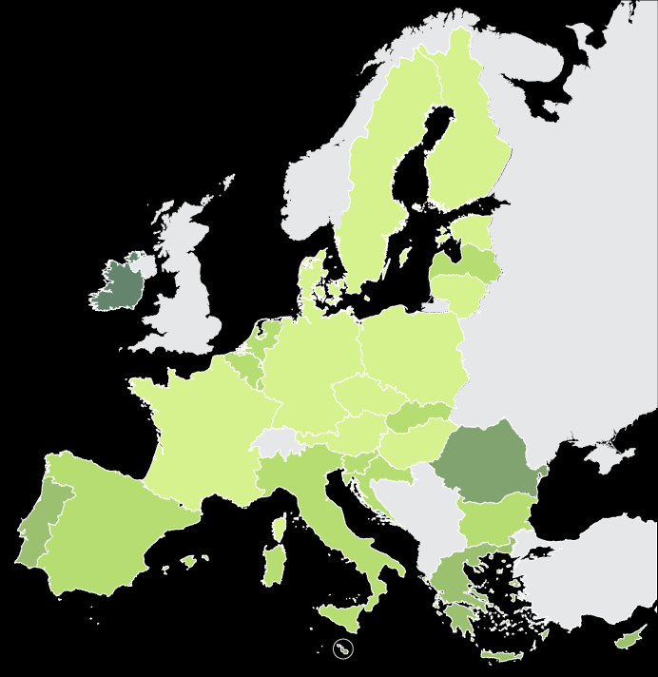
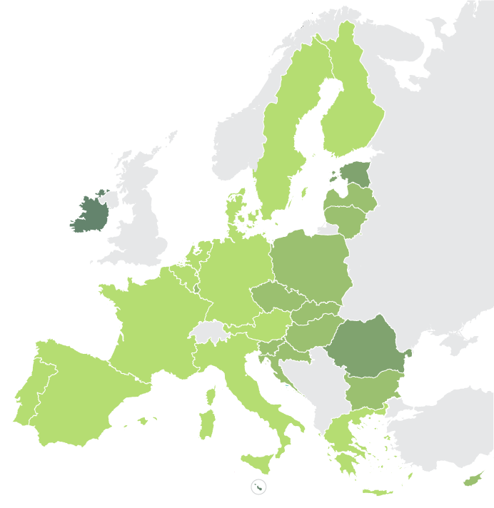
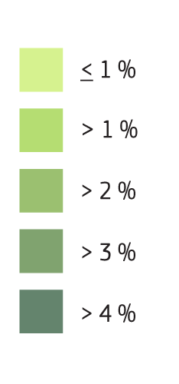
EU growth map 2023 & 2024
Real GDP growth, %

Slide 10
Headline inflation declines but core inflation remains elevated
Inflation breakdown, EU

Slide 11
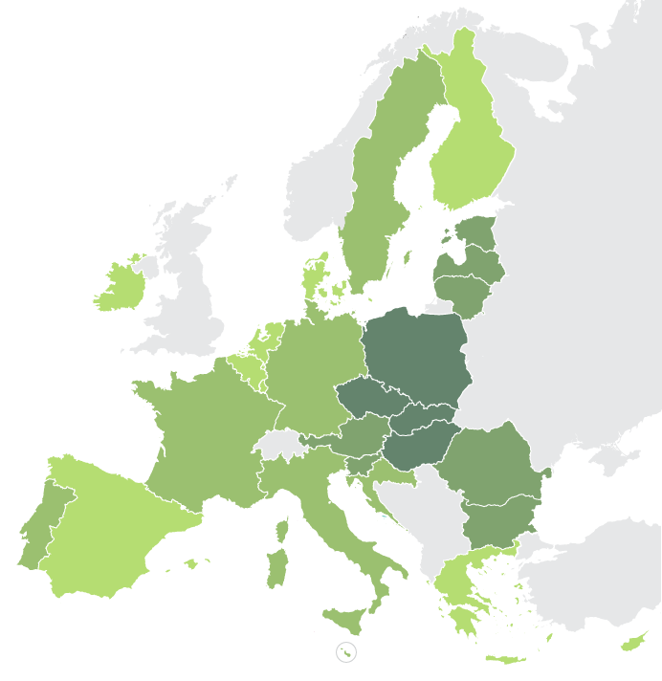
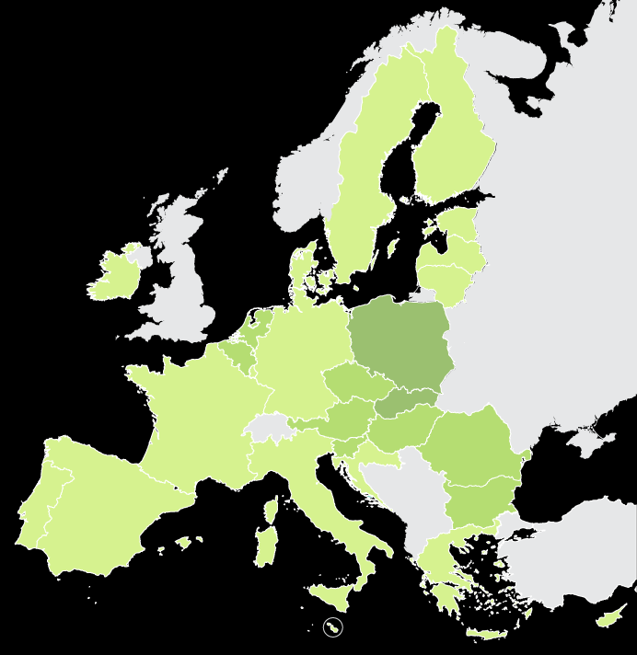
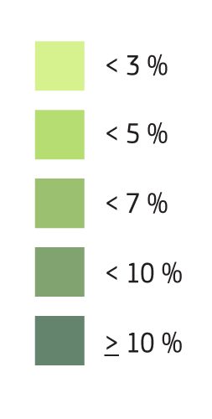
EU inflation map 2023 & 2024
Annual HICP inflation, %

Slide 12
Government deficits and debt ratios are on the mend
General government budget balance, EU
General government debt-to-GDP ratio, EU

Slide 13
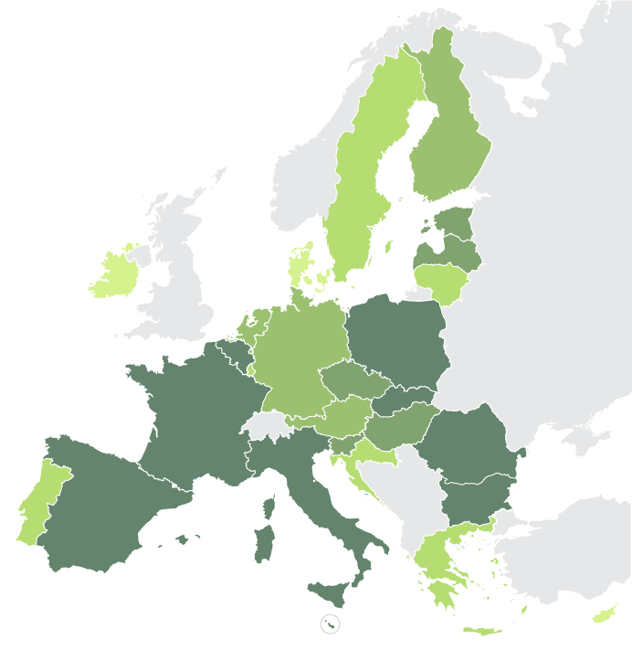
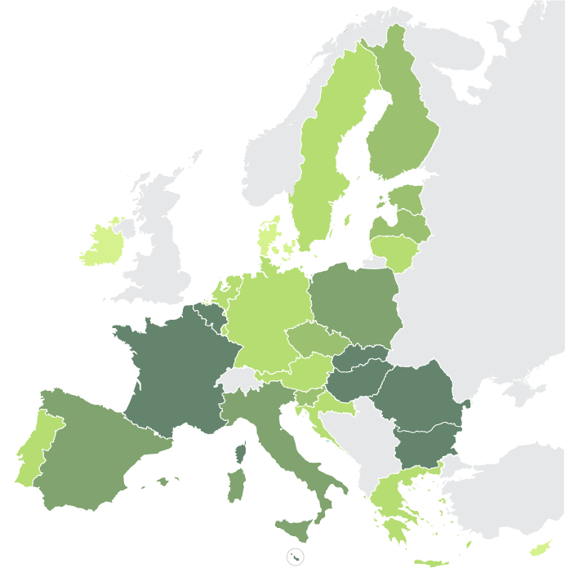
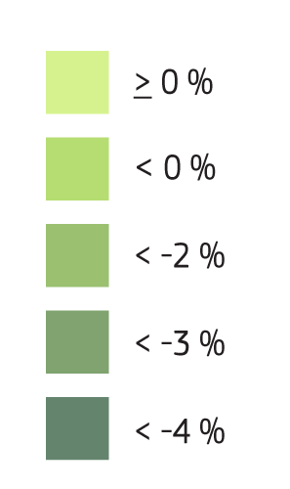
Budgetary outlook 2023 & 2024
Public deficits as % of GDP

Slide 14
Risks are tilted to the downside
- Higher-than-expected core inflation
Stronger reaction of monetary policy leading to higher interest rates
Less supportive international environment with heightened financial risks
+ Quicker pass-through of lower energy prices to firms and consumers
+ Lower headline inflation and stronger than expected private consumption

Slide 15
EU growth map 2023 & 2024
Real GDP growth, %

